Slide 1

HOUSE PRICE PREDICTION – project 2
Deborah Paul​

Slide 2
Outline
Business Problem
Dataset
​Methods
Model development
Results/conclusion

Slide 3
Business Problem
The house data for properties sold in the Northwestern County region is provided. A suitable statistical model must be developed to predict the house price of the property based on the selected features that impact the house price of properties.
The model can help real estate agents to assess market trends and provide suitable advice to their clients.

Slide 4
Dataset
21597, 20
kc_house_data.csv
The dataset has 21597 rows and 20 columns.
The column names are the following: date, price, bedrooms, bathrooms, sqft_living, sqft_lot, floors, waterfront, view, condition, grade, sqft_above, sqft_basement, yr_built, yr_renovated, zipcode, lat, long, sqft_living15 and sqft_lot15.

Slide 5
Methods
ETL (extract, transform, and load)
Data has been extracted from the data source, and cleaned of null values, and duplicates in Python.
Identifying key variables
The important variables used for the modeling are identified through various steps such as incompatible datatype elimination, multicollinearity check, and identifying irrelevant features to the response variable.
Model development
OLS (Ordinary Least squares) regression model will be used several times until the model is fine-tuned to eliminate insignificant variables and the coefficient of determination accounts for reasonable variation in y value.

Slide 6
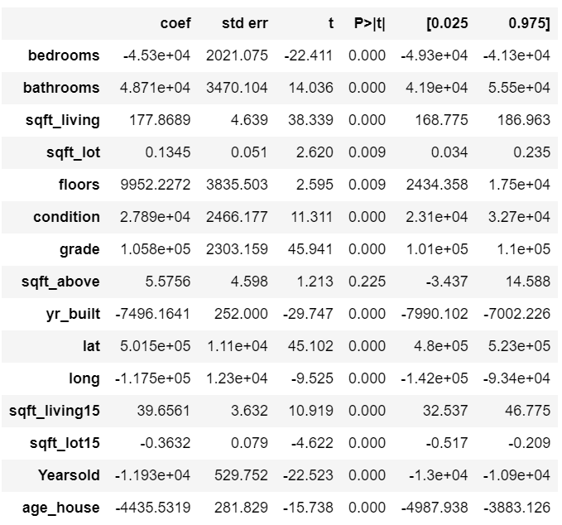
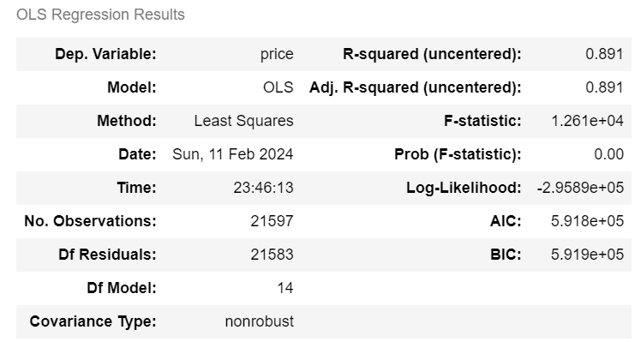
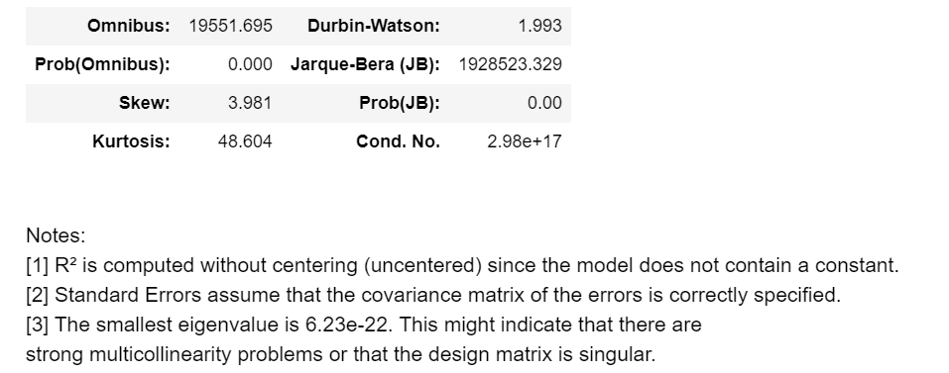
Model development
Initial model development after removing variables that have lot of null values and incompatible datatype:

Slide 7
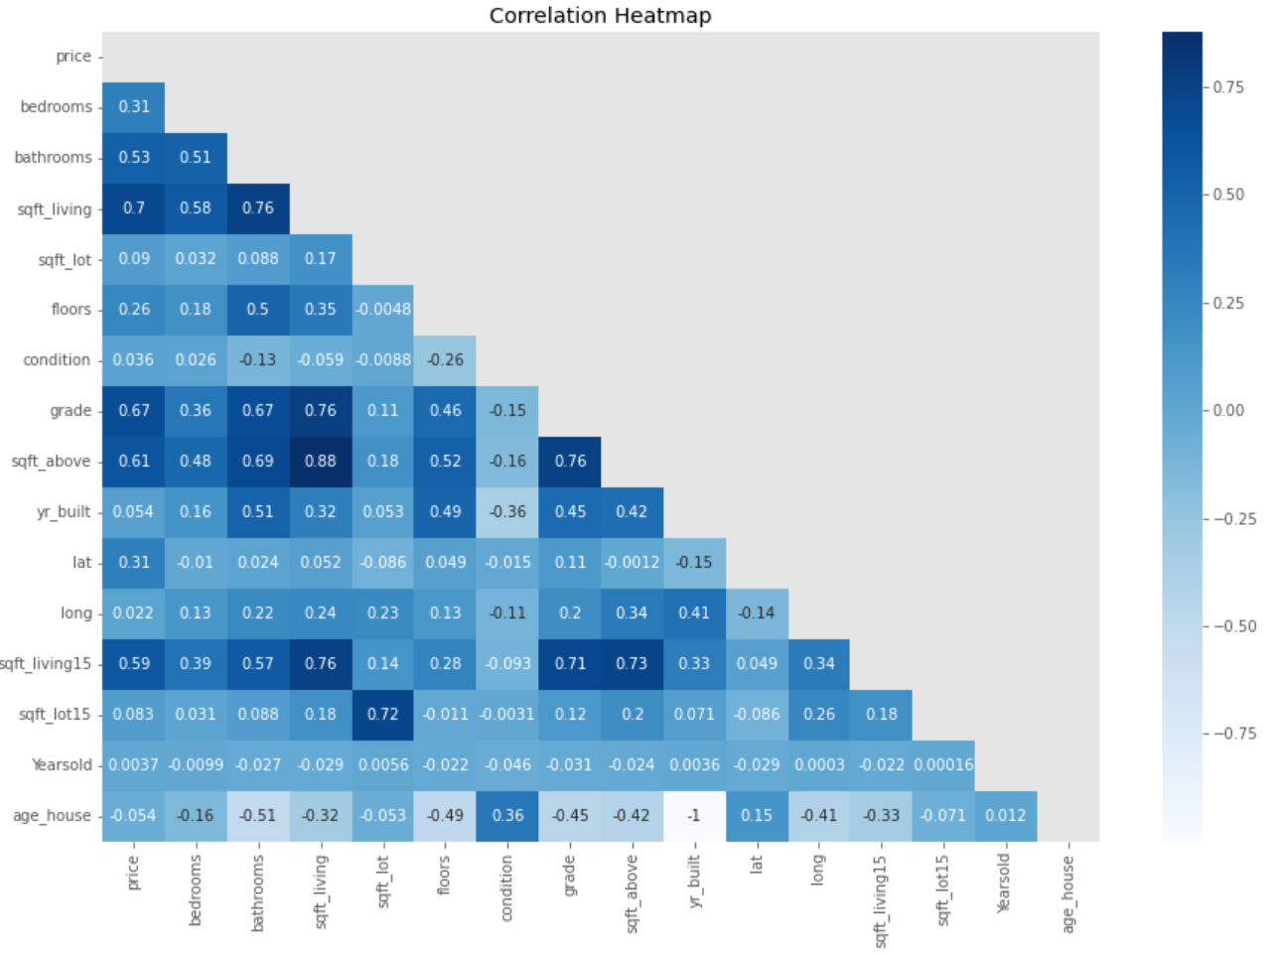
Model development(cont’d)
Multicollinearity check has been performed on the predictor variables and variables with high correlation with other x variables have been removed.

Slide 8
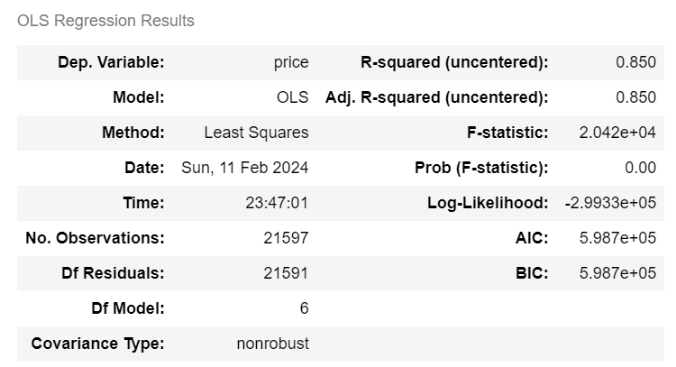
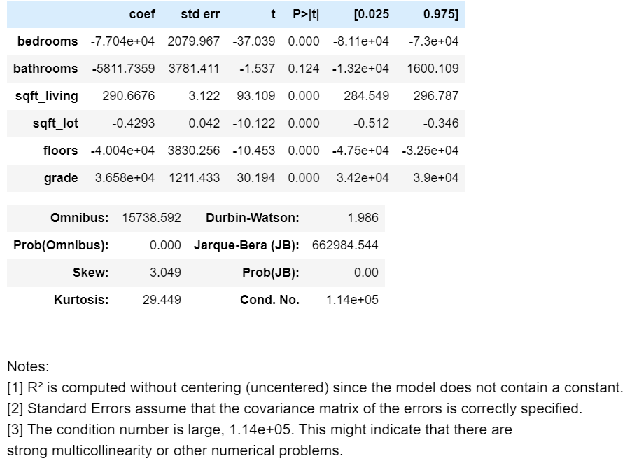
Model development(cont’d)

Slide 9
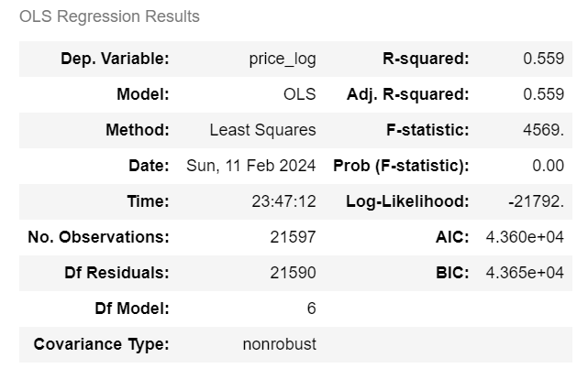
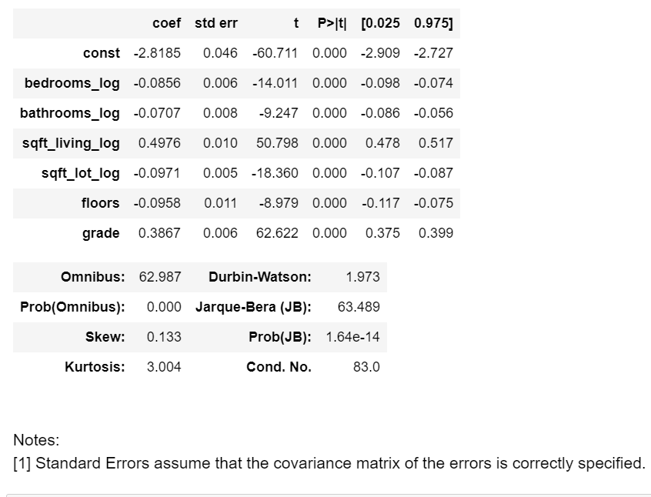
Model development(cont’d)
The variables have been split into continuous and categorical
The continuous variables have been normalized and log-transformed
One-hot encoding has been performed on categorical variables of the data.

Slide 10

Results/conclusion
The mean squared error is calculated for the train and test data with a split percentage of 0.15.
The final model has the R-squared value of 0.6 and significant variables such as the number of bedrooms, number of bathrooms, sqft of living area, sqft of lot, number of floors, and grade of the building. Hence these variables represent a 60% variation in the house price of the property.

Slide 11
THANK YOU
Deborah Paul
deboj777@gmail.com

